Slide 1
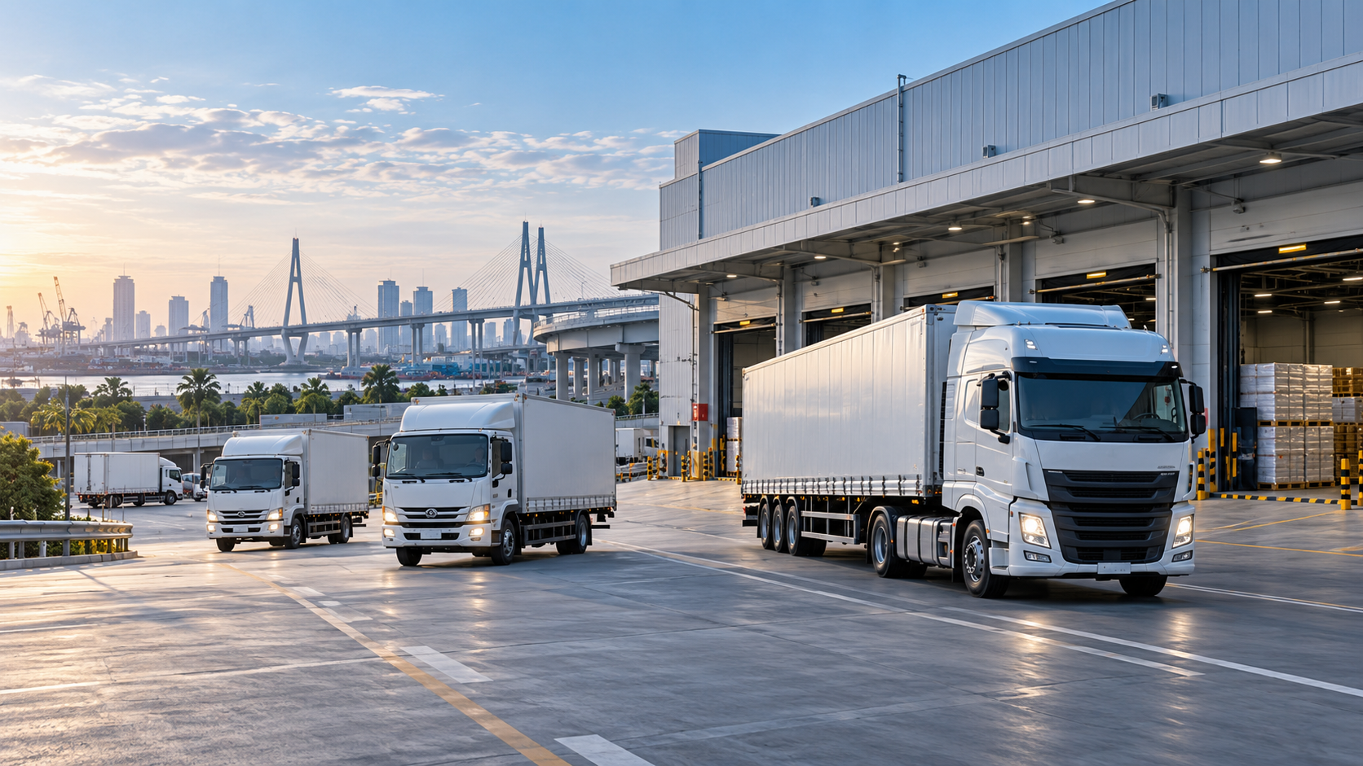

INTEGRATED WAREHOUSE
& LOGISTICS SOLUTION
Proposal for EMHART TECHNOLOGIES (THAILAND) LTD.
Manpower • Warehouse • VMI / I-WIS • Transportation
Rayong | New Project Opportunity
Notes:
[Sources]
User-provided project requirements and FigJam workflow.
AI-generated logistics warehouse image by OpenAI, generated for this presentation.
[/Sources]

Slide 2
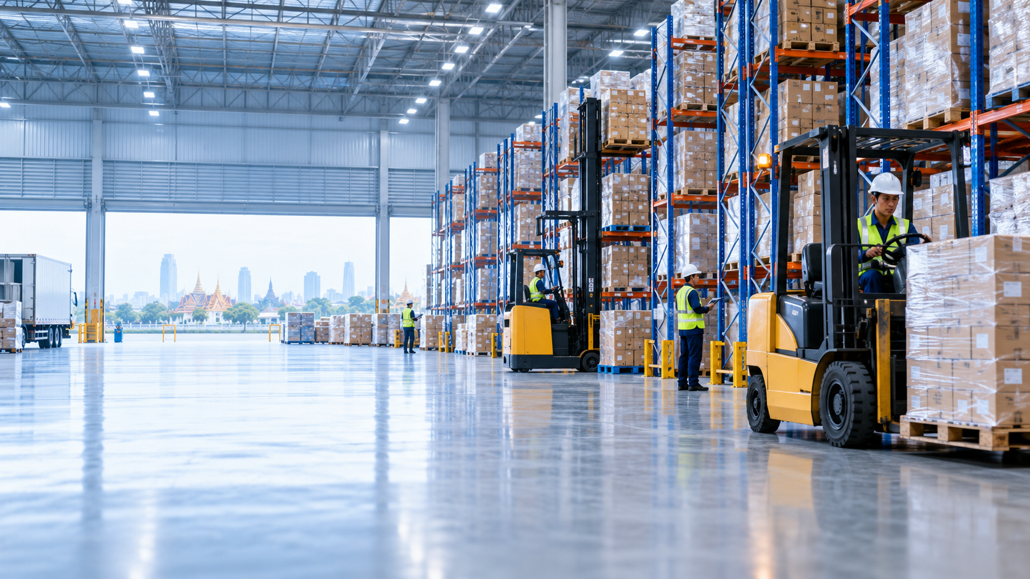
01 | Current Operation at a Glance
ภาพรวม Operation ปัจจุบันของคลัง Rayong
14 HC
3,800 m²
2,000
182
20 / mo.
IPACK WH Management
Current warehouse area
Pallet capacity
Customer base
Inbound containers
Operating model
Planning rule
08:00–17:00
OT after 17:00
Day shift only
Prepare / repack / ship
ตามแผน N+3 Day
Core system
Warehouse contract
SAP: Receive / Issue / Document
Excel: Packing Material
Current contract ends
March 2028
EMHART TECHNOLOGIES | Proposal
02
Notes:
[Sources]
User-provided project requirements and FigJam workflow.
AI-generated warehouse image by OpenAI, generated for this presentation.
[/Sources]

Slide 3
02 | Current Manpower Organization
14 HC สำหรับ Warehouse Management
Supervisor
1 HC
Leader
2 HC
Clerk
Receive
Repack
Auto Picker
Shipping
2 HC
2 HC
4 HC
2 HC
1 HC
Support by Emhart
QA 15 HC
EN & Maintenance 1 HC
CS 4 HC
Organization จาก FigJam สอดคล้องกับ Total 14 HC ของ IPACK
EMHART TECHNOLOGIES | Proposal
03
Notes:
[Sources]
User-provided FigJam organization chart.
[/Sources]

Slide 4
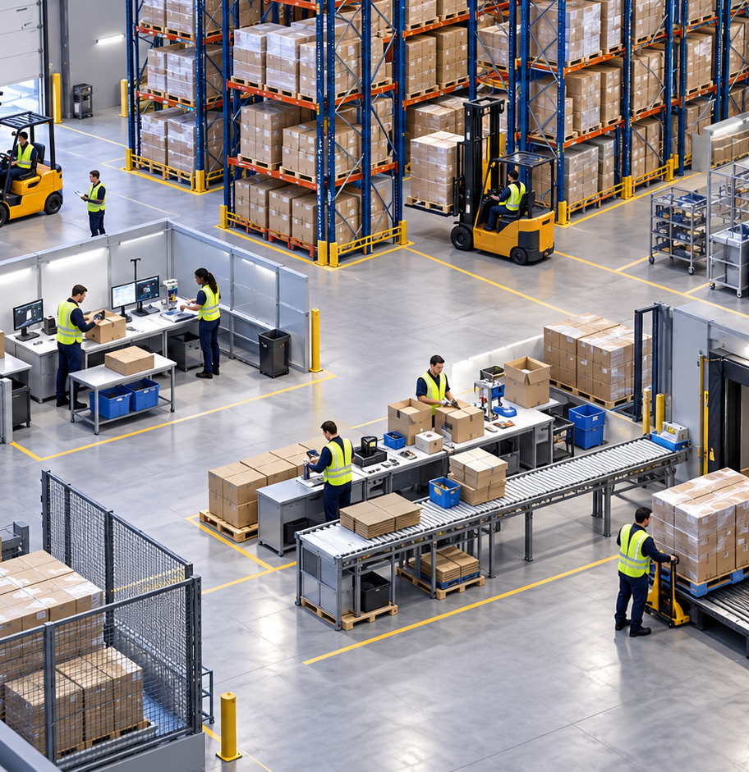
03 | Warehouse Work Flow
Current flow: Inbound → Storage → Outbound
1
RECEIVE
2
QA
3
STORE
4W/6W & Import
Emhart inspection
SAP location
4
PICK
5
REPACK
6
SHIP
Order / location
Customer STD
Load & dispatch
Supporting jobs: Packing Material Issue • Engineering/Maintenance Issue • Monthly Stock Count
EMHART TECHNOLOGIES | Proposal
04
Notes:
[Sources]
User-provided FigJam workflow.
AI-generated warehouse workflow image by OpenAI, generated for this presentation.
[/Sources]

Slide 5
04 | Operation Profile & Key Requirements
สิ่งที่ Solution ใหม่ต้องรองรับ
Buy & Sale
Manufacturing
MHE
High Value Zone
~20 containers / month
Repack ตาม customer quantity
Relabel ตาม customer requirement
Common parts ~10 SKU
ใช้กล่องเดิม + เปลี่ยน Label
Support Ayutthaya production
Reach Truck 2
Counterbalance 2
Auto Picker 2
Brass material
Restricted / locked zone
Need tighter control
Outbound frequency
Honda Ayutthaya
Honda Prachinburi
Minebea
Emhart Ayutthaya
22 / month
22 / month
13 / month
3–4 / week
EMHART TECHNOLOGIES | Proposal
05
Notes:
[Sources]
User-provided project requirements.
[/Sources]

Slide 6
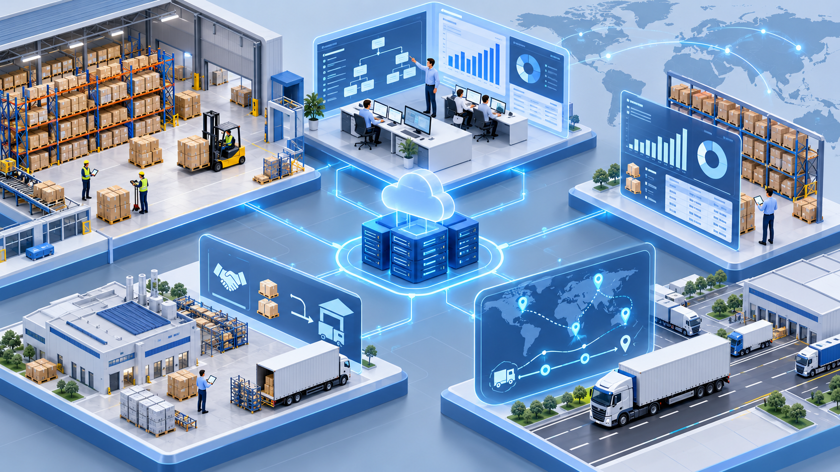
05 | The Opportunity
จาก Manpower Provider → Integrated Logistics Partner
MANPOWER + NEW WH
1
14 HC + warehouse sourcing
ลด Total Warehouse Cost
VMI + I-WIS
2
Inventory / location / packing material
Traceability & dashboard
TMS + TRANSPORT
3
Booking / route / POD / cost
Milk Run + Emhart transport
EMHART TECHNOLOGIES | Proposal
06
Notes:
[Sources]
User-provided Next Project requirements.
AI-generated digital logistics ecosystem image by OpenAI, generated for this presentation.
[/Sources]

Slide 7
06 | Project 1 — Manpower + New Warehouse
รักษา Service Level พร้อมลด Total Warehouse Cost
14 HC Warehouse Management
Capacity
Safety
≈ 2,000 pallets
Fire Protection System
Control
Operation
High-value restricted zone
Receiving / Repack / Shipping
MHE
Future
Support 6 forklifts
Expansion ready
Warehouse selection principle
Rent + Transport + Modification + Fire Protection + Relocation + Operating Cost
EMHART TECHNOLOGIES | Proposal
07
Notes:
[Sources]
User-provided warehouse requirements.
AI-generated warehouse image by OpenAI, generated for this presentation.
[/Sources]

Slide 8
07 | Project 2 — VMI + I-WIS
เปลี่ยน Inventory Control จาก Manual → Visible & Traceable
RECEIVE
LOCATION
Inbound control
SAP / WH location
STOCK
PICK / ISSUE
Inventory visibility
Material / FG issue
BALANCE
DASHBOARD
Variance check
KPI & history
Priority: ย้าย Packing Material Control จาก Excel เข้าสู่ระบบ
EMHART TECHNOLOGIES | Proposal
08
Notes:
[Sources]
User-provided VMI / I-WIS project requirement.
AI-generated digital logistics ecosystem image by OpenAI, generated for this presentation.
[/Sources]

Slide 9
08 | Project 3 — TMS + Transportation
Transportation Management System: plan, control and visibility
1
2
3
4
5
6
ORDER
PLAN
BOOK
PICKUP
DELIVER
POD
Milk Run
Emhart Transport
MMTh
Ford AAT
Toyota
Current external providers
→ compare current vs IPACK model
Target outcome
Route visibility • Vehicle utilization • POD • Cost monitoring • Transport history
EMHART TECHNOLOGIES | Proposal
09
Notes:
[Sources]
User-provided transportation requirements.
AI-generated logistics transport image by OpenAI, generated for this presentation.
[/Sources]

Slide 10
09 | Proposed Integrated Solution
เชื่อม People + Warehouse + System + Transportation เป็น End-to-End Flow
CUSTOMER
ORDER
SAP
WAREHOUSE
14 HC
I-WIS
VMI
TMS
TRANSPORT
INBOUND
OUTBOUND
Receive
Store
Pick
Repack
Ship
Deliver
One operating model • One visibility layer • Clear ownership across the flow
EMHART TECHNOLOGIES | Proposal
10
Notes:
[Sources]
Solution architecture synthesized from user-provided project scope.
[/Sources]

Slide 11
10 | New Warehouse Roadmap to 2028
เตรียมย้ายก่อนสัญญาคลังเดิมสิ้นสุด March 2028
PHASE 1
PHASE 2
PHASE 3
PHASE 4
ASSESS
FEASIBILITY
PREPARE
GO-LIVE
Current cost / stock / volume / productivity
Warehouse candidates / layout / fire / total cost
Contract / system / layout / relocation plan
Stock transfer / trial / stabilization
Now → Q1 2027
Q2 → Q3 2027
Q4 2027
Before Mar 2028
Key decision: เลือกคลังจาก Total Cost ไม่ใช่ Rental Cost เพียงอย่างเดียว
EMHART TECHNOLOGIES | Proposal
11
Notes:
[Sources]
Roadmap recommendation based on user-provided current warehouse contract end date: March 2028.
[/Sources]

Slide 12
11 | Commercial Options & Next Step
เสนอเป็น Module เพื่อให้ Emhart เลือก Scope และลงทุนเป็นลำดับ
A
B
C
D
MANPOWER
MANPOWER + WH
INTEGRATED WH
END-TO-END
14 HC WH Management
14 HC + New Warehouse
Manpower + WH + I-WIS
+ TMS + Transportation
Lowest change
Cost reduction focus
Inventory visibility
Full logistics solution
NEXT STEP
Site data collection → Current cost baseline → Warehouse search → Solution & quotation
IPACK: From Manpower Provider to Integrated Logistics Partner
EMHART TECHNOLOGIES | Proposal
12
Notes:
[Sources]
Commercial option structure recommended from the user-provided project scope.
[/Sources]

